Slide 1
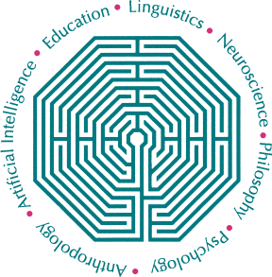
International Research Collaborations within Cognitive Science
Yoed N. Kenett
Technion – Israel Institute of Technology

Slide 2
Question #1
What defines international Cognitive Science Research?

Slide 3
The CogSci mission statement
The Cognitive Science Society brings together researchers from around the world who hold a common goal: understanding the nature of the human mind.
The mission of the Society is to promote Cognitive Science as a discipline, and to foster scientific interchange among researchers in various areas of study, including Artificial Intelligence, Linguistics, Anthropology, Psychology, Neuroscience, Philosophy, and Education.

Slide 4

Thoughts
Collaborations?
Shared resources?
Cross-cultural research?

Slide 5
Question #2
How can we facilitate International CogSci Research?

Slide 6

Thoughts
Communicating
Building bridges
Creating opportunities

Slide 7
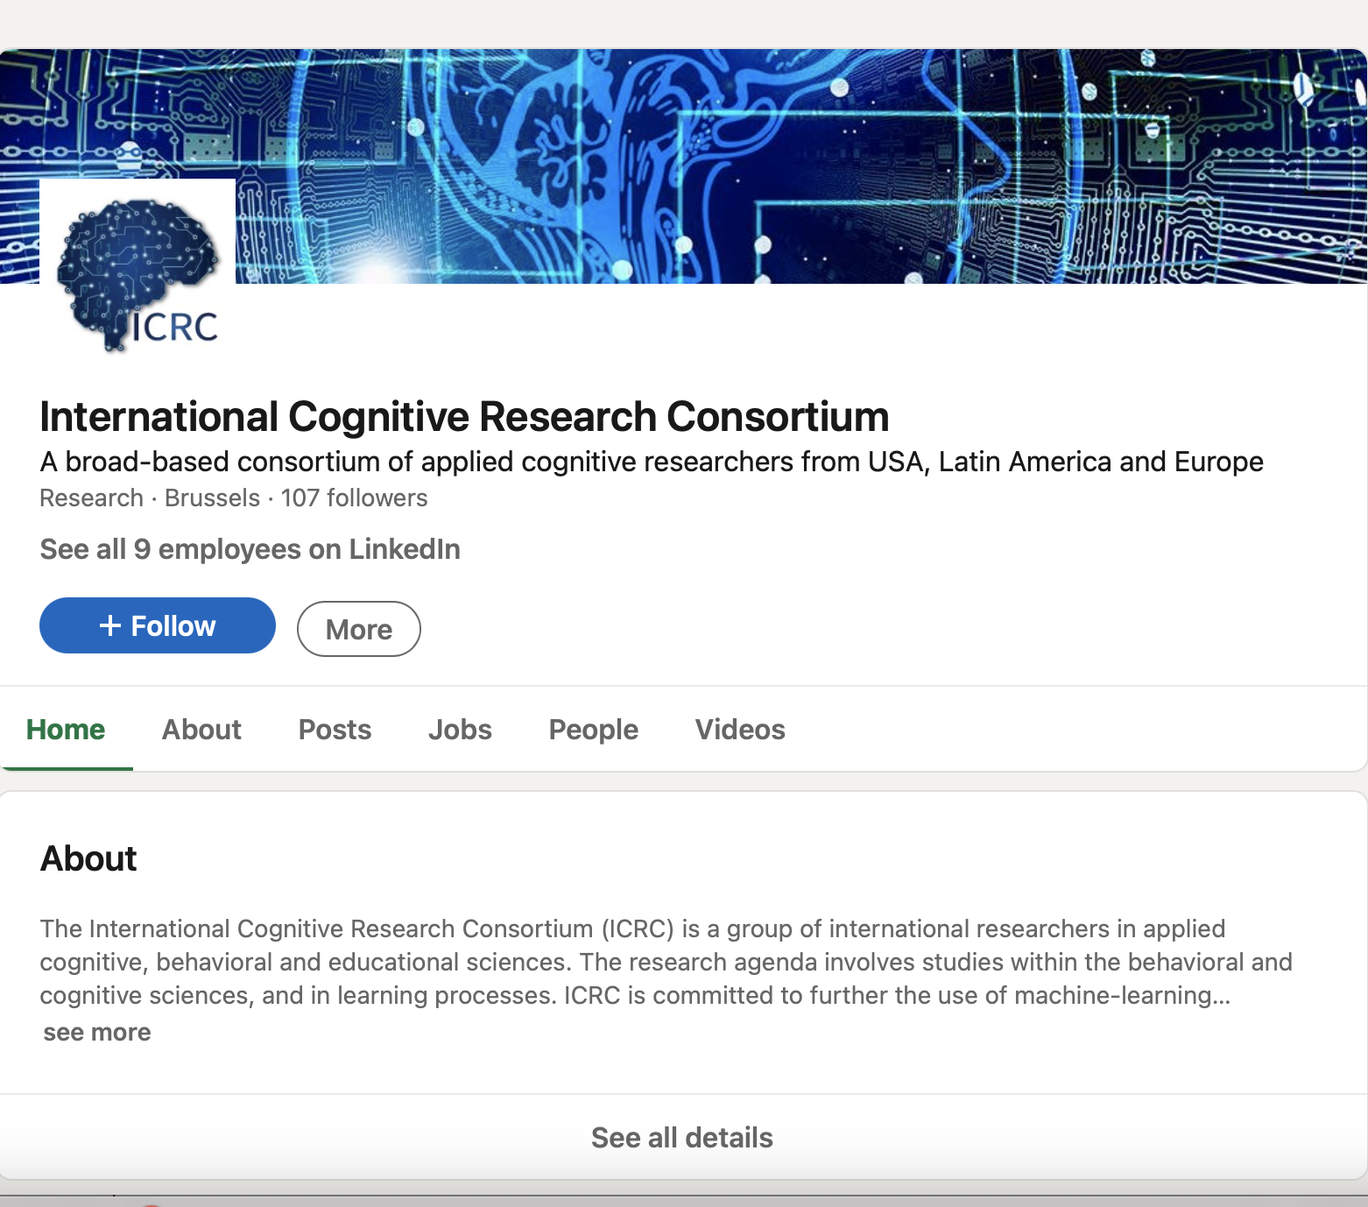
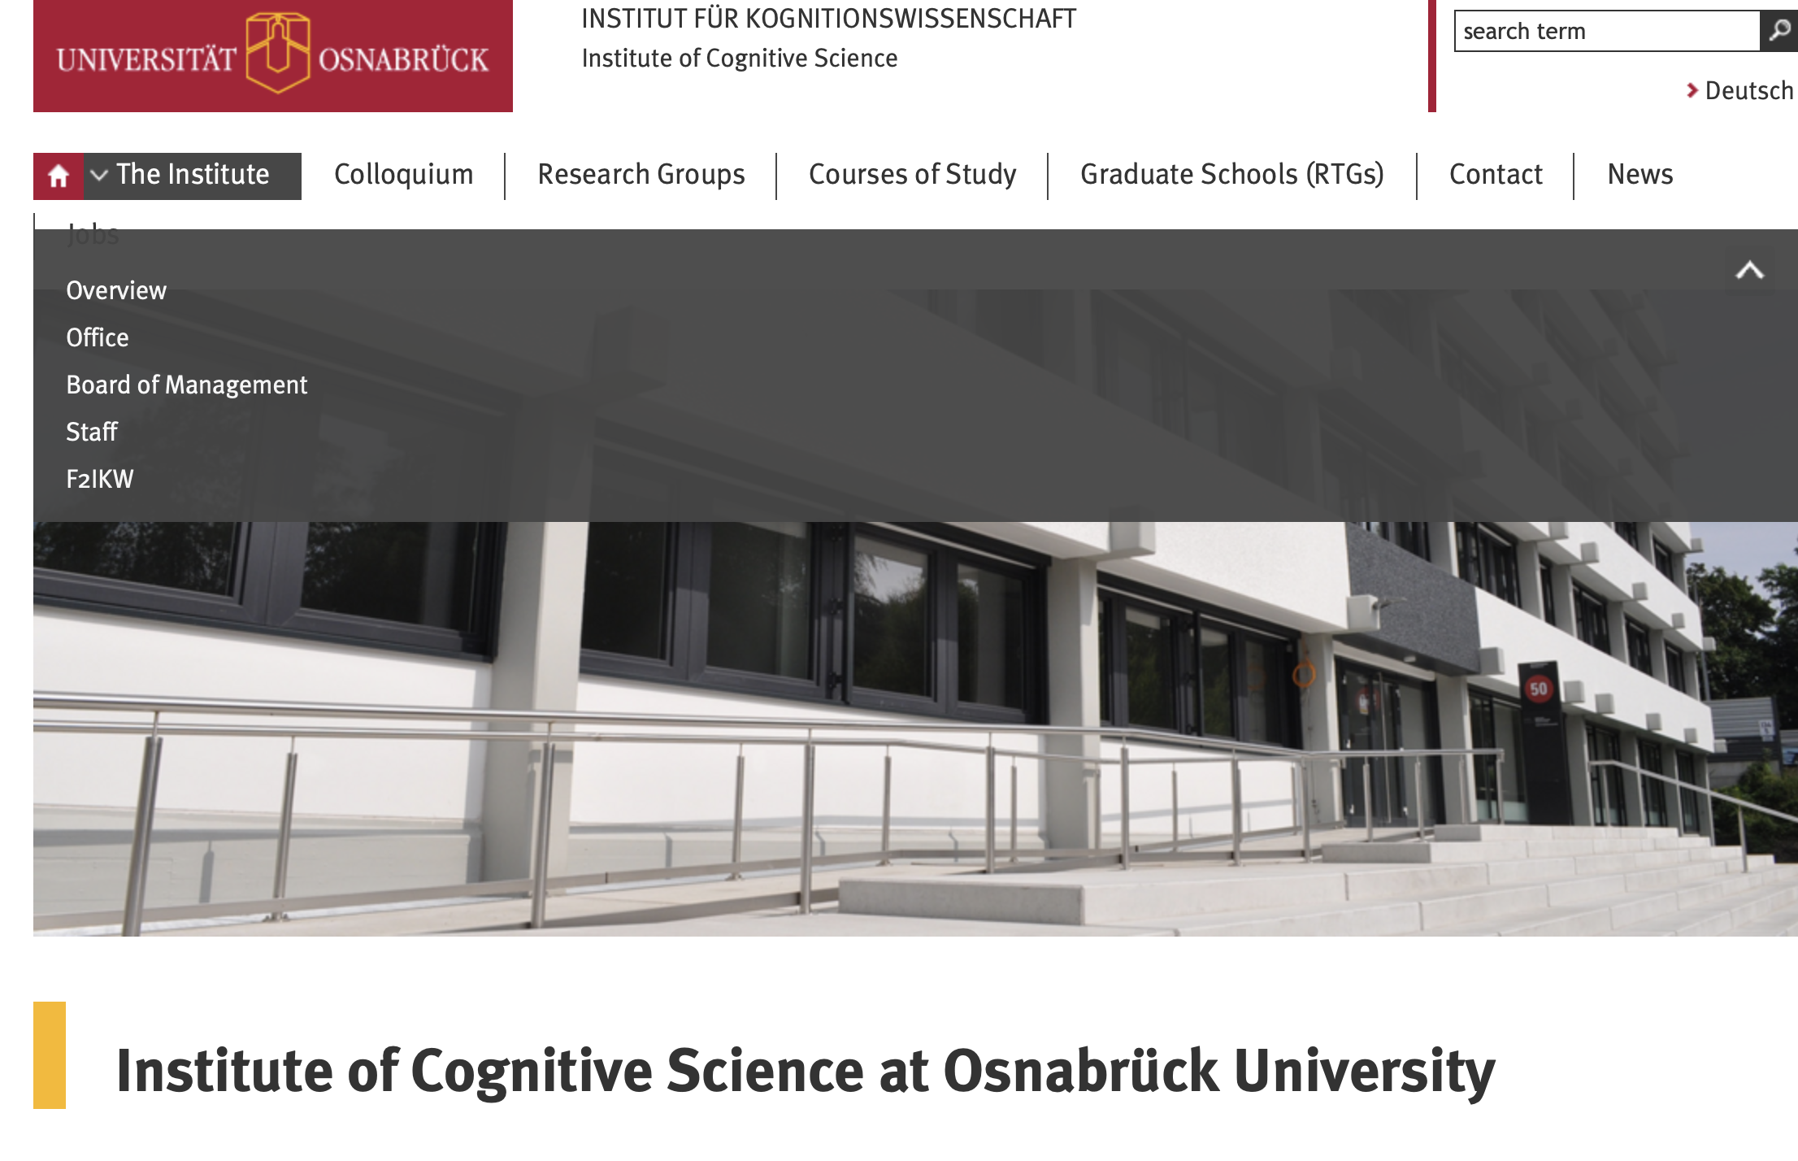
Success stories

Slide 8
Question #3
What are the barriers for international CogSci Research and how can they be overcome?

Slide 9

Thoughts
Transparency
Accessibility
Language
Country-bias
Funding

Slide 10
Question #4
How can we build/enhance the infrastructure needed to support international cogSci Research?

Slide 11

Thoughts
Funding mechanisms
Research infrastructure
Think groups
Maximize transparency
Research consortiums
Multi-lab cognitive research

Slide 12
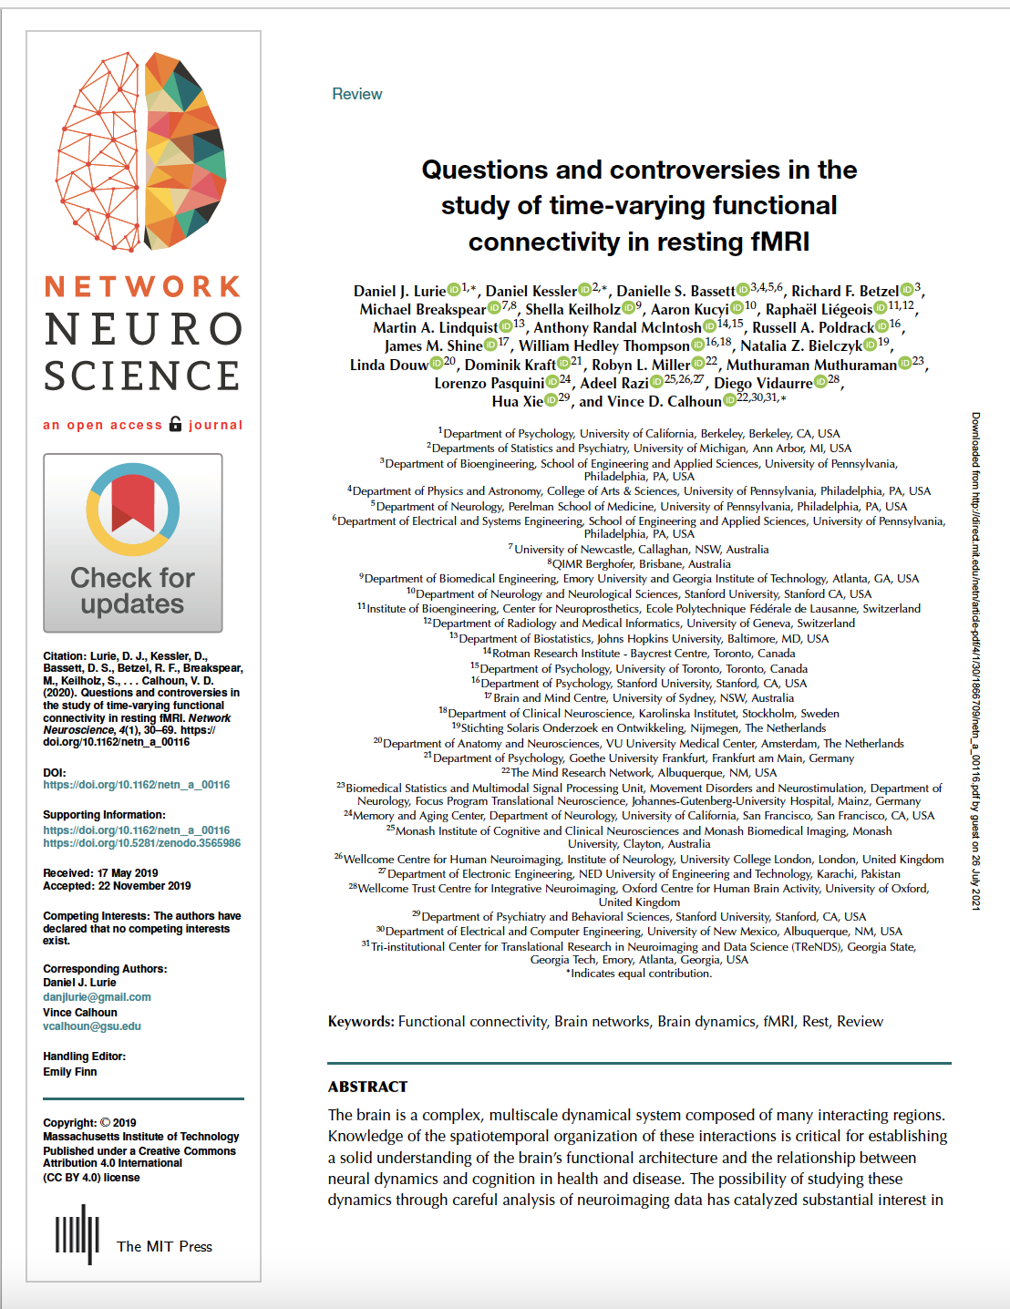
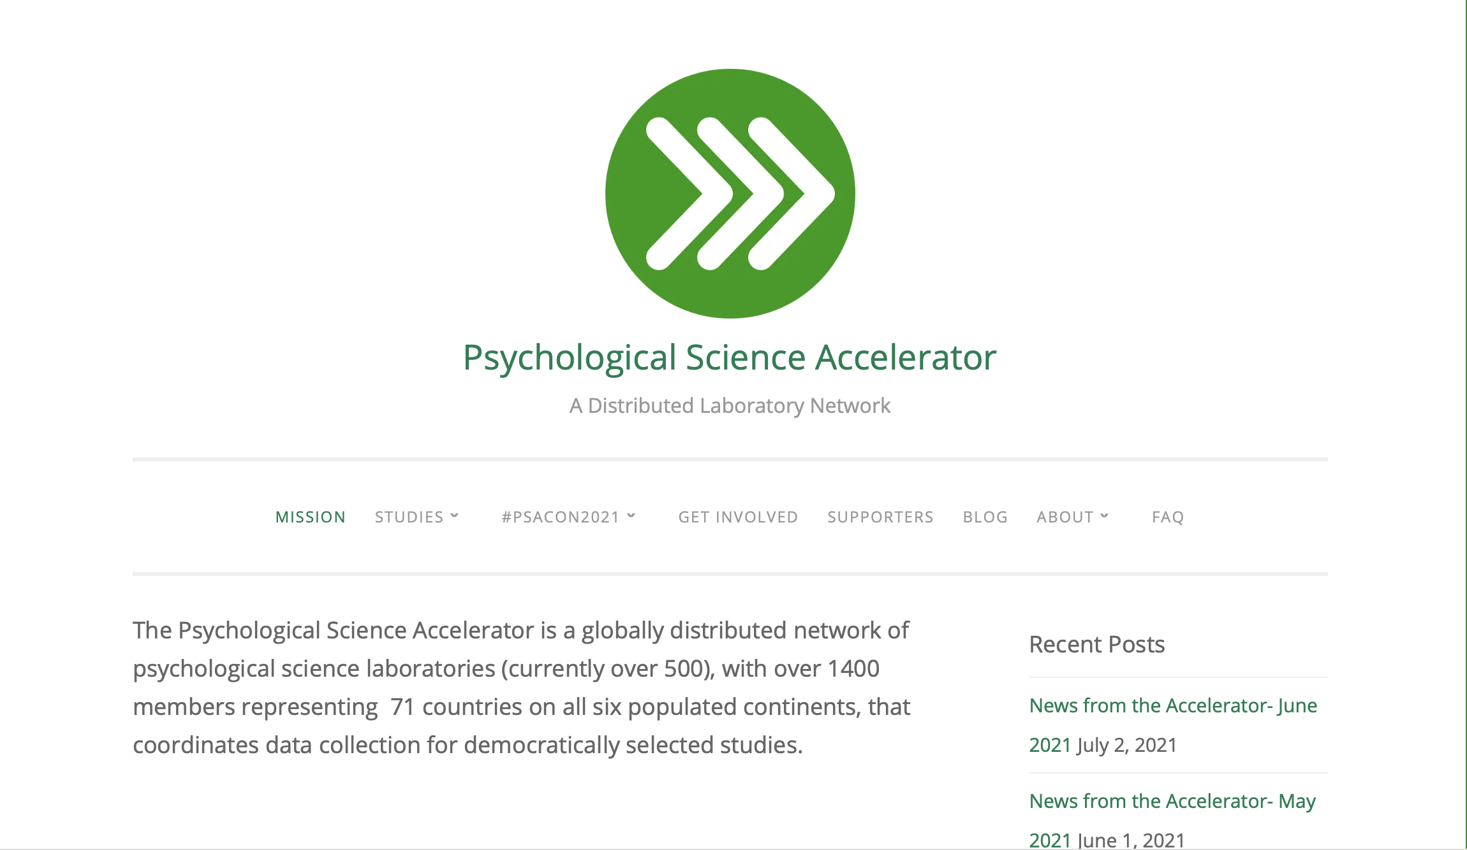
Success stories

Slide 13
Questions
What defines international CogSci Research?
How can we facilitate International CogSci Research?
What are the barriers for international CogSci Research and how can they be overcome?
How can we build/enhance the infrastructure needed to support international cogSci Research?

